Slide 1
RM With Kafka
Setup Document

Slide 2
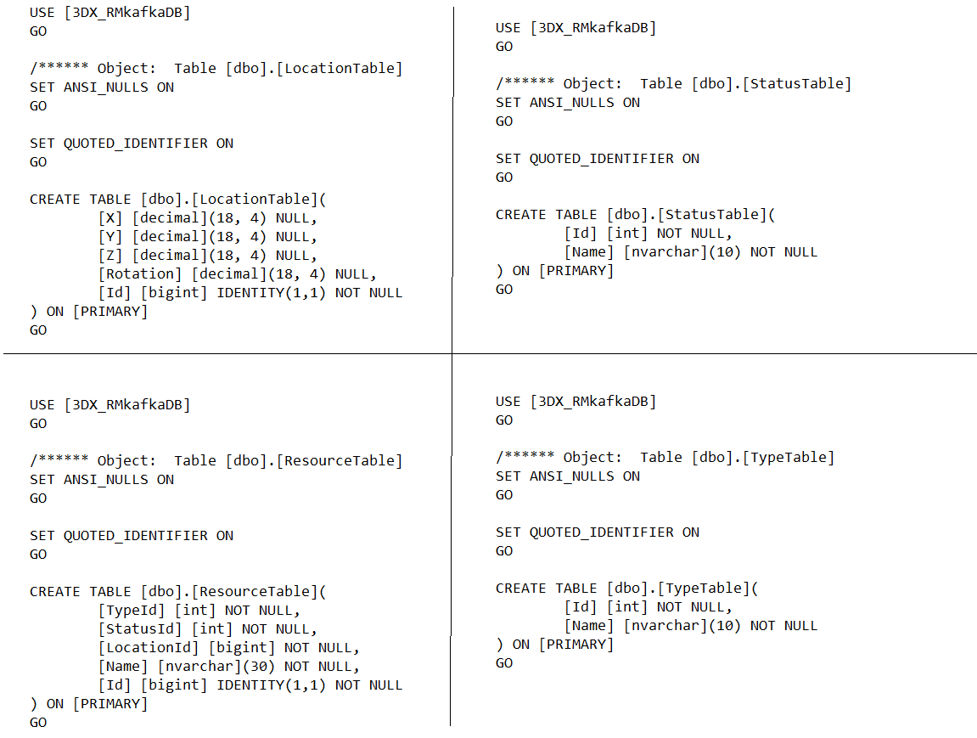
Create Database
Create Database with Name [3DX_RMkafkaDB]
Create Tables (LocationTable,ResourceTable,StatusTable,TypeTable) by using below command

Slide 3
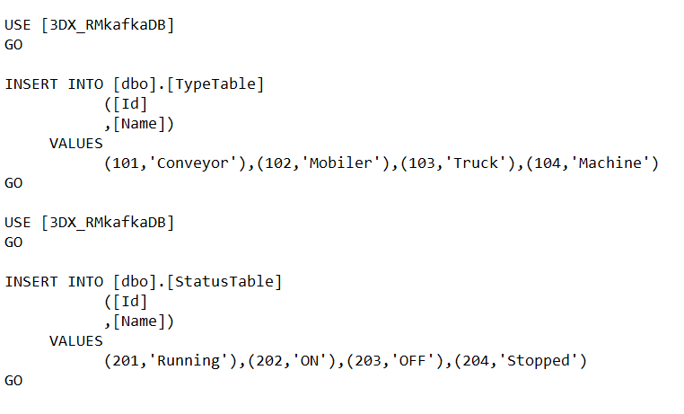
3) Insert values to Statustable , Typetable using below commands

Slide 4
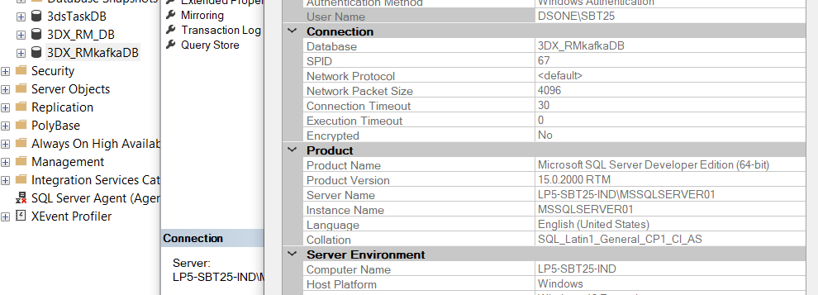
RM_Kafka_API
Steps to be followed to setup Resource Management Api App:-
We have to update the DB connection string which is residing in Global.asx file
Open SSMS, right click on the database, go to database property, then go to connection properties, copy the server name and replace it in the initial string of the connection string mentioned in Global.asx file.

Slide 5
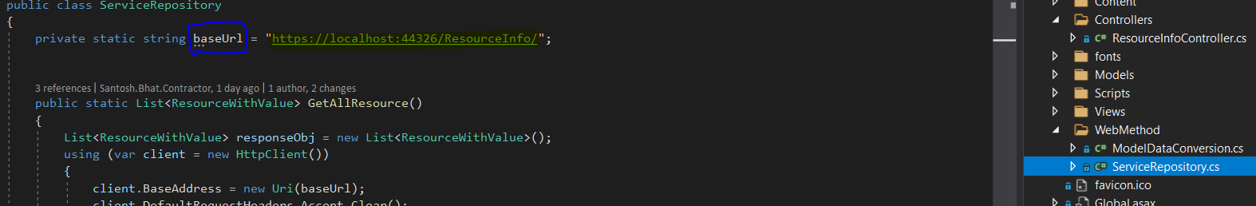
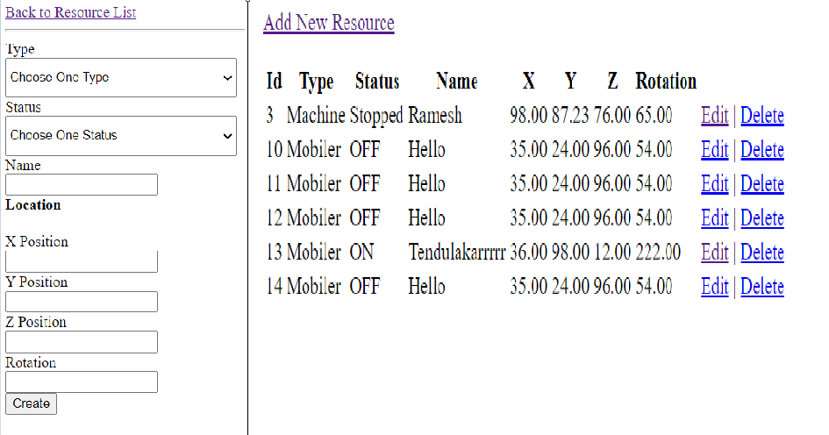
RM client App
1. If there is any changes in RM_API host url address, you can update baseUrl of WebMethod.ServiceRepository
2. Run the application with address https://localhost:[port]/ResourceInfo/AddResource
You get add resource , edit , delete options

